Slide 1
2026秋季学期·西方哲学史（下）
霍布斯
主讲人：赵新侃
zhaoxinkan@pku.edu.cn

Slide 2
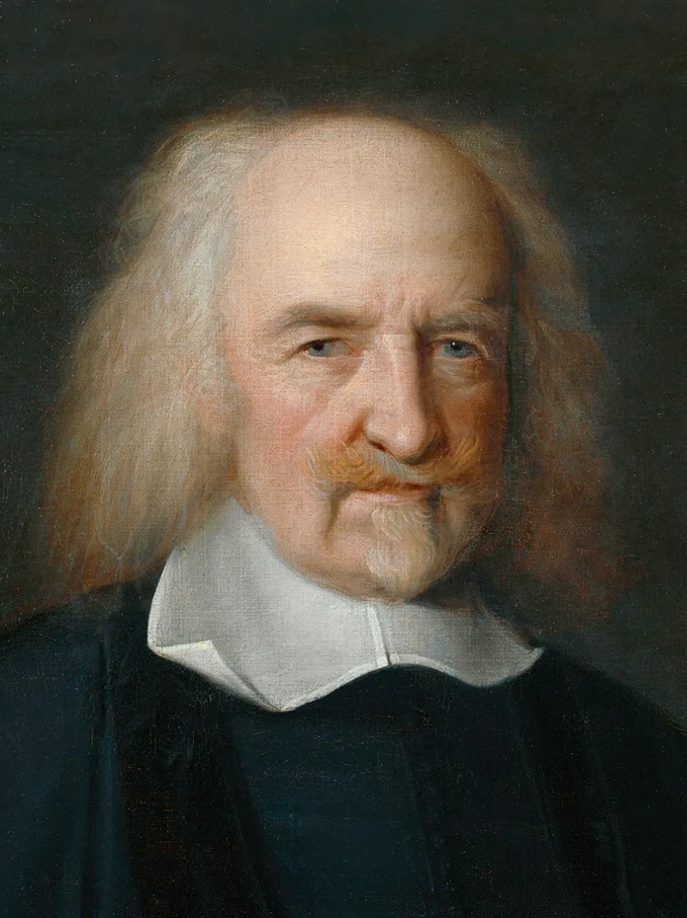
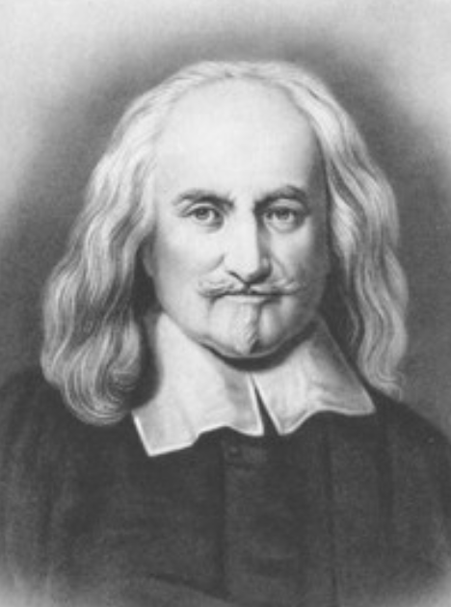
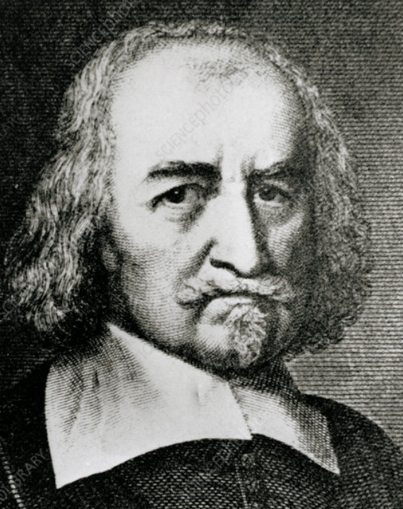
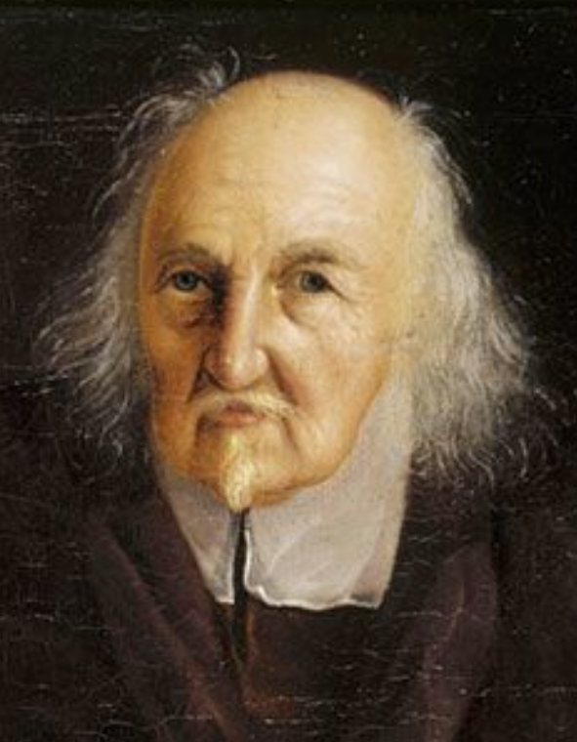
生平
1588
《法的要素》1640
批评笛卡尔
《利维坦》1651
1679

Slide 3
唯物的经验论
感觉的基础地位
  感觉是被动接受的过程
  感觉是一切观念的基础；记忆、想象、推理等都基于感觉
  两种知识：事实知识、后果知识
唯物论图景下的感觉
  感觉器官投射幻象：声色味等是心脑的向外抵制
  （注意与笛卡尔的相似）

Slide 4
The cause of sense is the external body, or object, which presses the organ proper to each sense, either immediately, as in taste and touch; or mediately, as in seeing, hearing, and smelling. This pressure, by the mediation of the nerves, and other strings, and membranes of the body, continued inwards to the brain and heart, causes there a resistance, or counter-pressure, or endeavour of the heart to deliver itself. This endeavour, because outward, seems to be some matter without. And this seeming, or fancy, is that which men call sense; and it consists, as to the eye, in a light or colour figured; to the ear, in a sound; to the nostril, in an odour; to the tongue and palate, in a savour; and to the rest of the body in heat, cold, hardness, softness, and such other qualities as we discern by feeling. All which qualities called sensible are in the object that causes them but so many several motions of the matter, by which it presses our organs diversely.

Slide 5
唯名论与语言
对共相问题的处理
  不存在共相
  所有词都是名字，命名一个或多个个体
  句子的真值在于名字命名关系的恰当重叠
  例：“人是生物”，“所有人都是正义的”
对语言的一般论述
  人类和动物的最大区别
  语言的功能：记录知识、咨询与讲授、声明意愿、娱乐
  语言是筹码而非实值：Words are wise men’s counters, they do but reckon by them; but they are the money of fools.

Slide 6
心灵与意志
批评笛卡尔：无身体的实体如同圆的方

